Slide 1
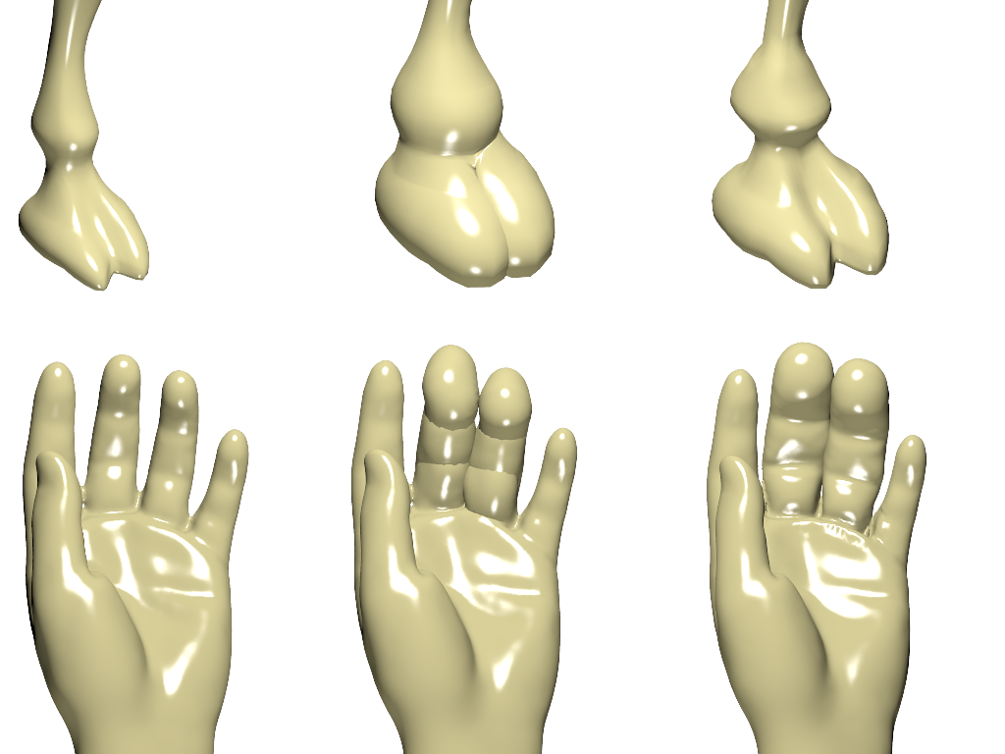
(a) Original
(b) Inflate Brush
(c) Enhance Brush

